Slide 1





Module 05 – Processes
WWW.SELACLOUD.COM

Slide 2

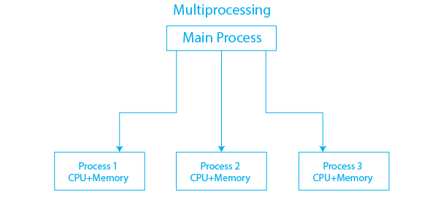
multiprocessing
multiprocessing module is responsible for processes creation and management
multiprocessing API is similar to threading API and it extends the threading module functionality
Python processes avoid the Global Interpreter Lock (GIL)and take full advantages of multiple processors on a machine
multiprocessing module includes a lot of useful classes for — processes creation, synchronization and IPC
Notes:
Python is dynamically-typed and garbage-collected. It supports multiple programming paradigms, including structured (particularly, procedural), object-oriented and functional programming.
It was built to be as readable as possible, and is significant indentation driven (Off-side rule).
The language's core philosophy is summarized in the document The Zen of Python (PEP 20), which includes aphorisms such as:
Beautiful is better than ugly.
Explicit is better than implicit.
Simple is better than complex.
Complex is better than complicated.
Readability counts.
For further reading:
Python (programming language) - Wikipedia

Slide 3
The multiprocessing.Process class
We can use the Process class to create a process object
Process(group=None, target=None, name=None, args=())
— target is the callable object to be invoked by the Process
— name is the process name
— args is the argument tuple for the target invocation.
— group — should be always be None
Notes:
Python is dynamically-typed and garbage-collected. It supports multiple programming paradigms, including structured (particularly, procedural), object-oriented and functional programming.
It was built to be as readable as possible, and is significant indentation driven (Off-side rule).
The language's core philosophy is summarized in the document The Zen of Python (PEP 20), which includes aphorisms such as:
Beautiful is better than ugly.
Explicit is better than implicit.
Simple is better than complex.
Complex is better than complicated.
Readability counts.
For further reading:
Python (programming language) - Wikipedia

Slide 4
Process start and join functions
start() - Starts the process’s activity.
join([timeout])
— Block the calling method until the process whose join() method is called terminates or until the optional timeout occurs.
— If timeout parameter specified the calling method will be blocked up to timeout seconds. The exitcode will stays None until the process is actually finishes (Will be discussed later)”

Slide 5
The Process example

Slide 6
The Process example
from multiprocessing import Process, current_process def f(val): cp = current_process() print("In child process: name={}, pid={}, val={}".format(cp.name, cp.pid, val)) if __name__ == '__main__': p = Process(target=f, args=('param_val',)) p.start() p.join()

Slide 7
The Process example — cont’d
In some platform, like windows, the child process goes through the main space before executing the target function. This is why the creation of child process must be ' f under the: if __name__==“__main__’’
Single-item tuples require a trailing comma:
tpl = (1,)
Notes:
PyCharm is currently one of the most used IDE for python development, It provides code analysis, a graphical debugger, an integrated unit tester, integration with version control systems (VCSes), and supports web development with Django as well as data science with Anaconda.
It was created by JetBrains
It is mostly popular because of many things, such as:
It is considered as an intelligent code editor, fast and safe refactoring, and smart code.
Features for debugging, profiling, remote development, testing the code, auto code completion, quick fixing, error detection and tools of the database.
Support for Popular web technologies, web frameworks, scientific libraries and version control.

Slide 8
join with timeout example
import multiprocessing as MP
import time
def func():
for n in range(100000000):
pass
if __name__ == "__main__":
p = MP.Process(target=func)
p.start() The output:
p.join(1)
while p.exitcode is None: In loop
print("in loop") In loop
p.join(1) In loop
time.sleep(1) In loop
Notes:
PyCharm is currently one of the most used IDE for python development, It provides code analysis, a graphical debugger, an integrated unit tester, integration with version control systems (VCSes), and supports web development with Django as well as data science with Anaconda.
It was created by JetBrains
It is mostly popular because of many things, such as:
It is considered as an intelligent code editor, fast and safe refactoring, and smart code.
Features for debugging, profiling, remote development, testing the code, auto code completion, quick fixing, error detection and tools of the database.
Support for Popular web technologies, web frameworks, scientific libraries and version control.

Slide 9
Exchanging data between processes
When it comes to communicating between processes, the multiprocessing modules has two primary methods:
— Queues
— Pipes
Notes:
PyCharm is currently one of the most used IDE for python development, It provides code analysis, a graphical debugger, an integrated unit tester, integration with version control systems (VCSes), and supports web development with Django as well as data science with Anaconda.
It was created by JetBrains
It is mostly popular because of many things, such as:
It is considered as an intelligent code editor, fast and safe refactoring, and smart code.
Features for debugging, profiling, remote development, testing the code, auto code completion, quick fixing, error detection and tools of the database.
Support for Popular web technologies, web frameworks, scientific libraries and version control.

Slide 10
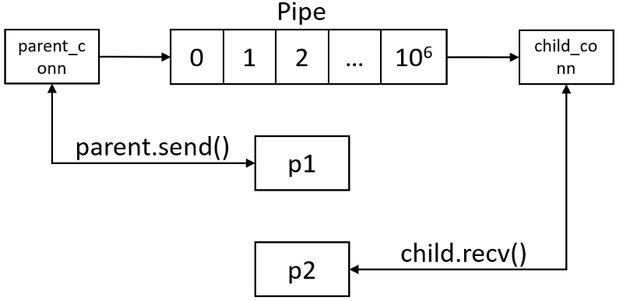
Exchanging data between processes — Queue
Multiprocessing Queue main functions:
— put
— put_nowait
— get
— get_nowait
— empty / full
Notes:
PyCharm is currently one of the most used IDE for python development, It provides code analysis, a graphical debugger, an integrated unit tester, integration with version control systems (VCSes), and supports web development with Django as well as data science with Anaconda.
It was created by JetBrains
It is mostly popular because of many things, such as:
It is considered as an intelligent code editor, fast and safe refactoring, and smart code.
Features for debugging, profiling, remote development, testing the code, auto code completion, quick fixing, error detection and tools of the database.
Support for Popular web technologies, web frameworks, scientific libraries and version control.

Slide 11
The Process - Queue

Slide 12
Exchanging data between processes — Queue
from multiprocessing import Process, Queue def f(q): q.put(["one", "two",3]) if __name__ == "__main__": q = Queue() p = Process(target=f, args=(q,)) p.start() print(q.get()) #prints (["one", "two",3] p.join() q.close()
Notes:
PyCharm is currently one of the most used IDE for python development, It provides code analysis, a graphical debugger, an integrated unit tester, integration with version control systems (VCSes), and supports web development with Django as well as data science with Anaconda.
It was created by JetBrains
It is mostly popular because of many things, such as:
It is considered as an intelligent code editor, fast and safe refactoring, and smart code.
Features for debugging, profiling, remote development, testing the code, auto code completion, quick fixing, error detection and tools of the database.
Support for Popular web technologies, web frameworks, scientific libraries and version control.

Slide 13
Exchanging data between processes -— Pipe
Pipe() returns a pair of connection objects connected by a pipe which by default is duplex (two-way)
- Each connection object has send() and recv() methods
A Pipe can only have two endpoints
A Pipe is much faster
Notes:
PyCharm is currently one of the most used IDE for python development, It provides code analysis, a graphical debugger, an integrated unit tester, integration with version control systems (VCSes), and supports web development with Django as well as data science with Anaconda.
It was created by JetBrains
It is mostly popular because of many things, such as:
It is considered as an intelligent code editor, fast and safe refactoring, and smart code.
Features for debugging, profiling, remote development, testing the code, auto code completion, quick fixing, error detection and tools of the database.
Support for Popular web technologies, web frameworks, scientific libraries and version control.

Slide 14
The Process - Pipe

Slide 15
Exchanging data between processes — Pipe
from multiprocessing import Process, Pipe def f(conn): conn.send(['hello', 'world']) conn.close() if __name__ == '__main__’: parent_conn, child_conn = Pipe() p = Process(target=f, args=(child_conn,)) p.start() print(parent_conn.recv()) # ['hello’, 'world’] p.join()
Notes:
PyCharm is currently one of the most used IDE for python development, It provides code analysis, a graphical debugger, an integrated unit tester, integration with version control systems (VCSes), and supports web development with Django as well as data science with Anaconda.
It was created by JetBrains
It is mostly popular because of many things, such as:
It is considered as an intelligent code editor, fast and safe refactoring, and smart code.
Features for debugging, profiling, remote development, testing the code, auto code completion, quick fixing, error detection and tools of the database.
Support for Popular web technologies, web frameworks, scientific libraries and version control.

Slide 16
Synchronization between processes
Take a look at the following program:
import multiprocessing as MP import sys def loop(): for i in range(400): sys.stdout.write(str(i)+" ") sys.stdout.flush() sys.stdout.write("in process ") sys.stdout.flush() sys.stdout.write(MP.current_process().name+ "\n") sys.stdout.flush() if __name__ == "__ main__": MP.Process(target=loop, name="child1").start() MP.Process(target=loop, name="child2").start() for i in range(400): sys.stdout.write(str(i)+" ") sys.stdout.flush() sys.stdout.write("in process ") sys.stdout.flush() sys.stdout.write(MP.current_process().name+ "\n") sys.stdout.flush()

Slide 17
Synchronization between processes-cont’d
multiprocessing module has 3 classes for process synchronization:
Lock - non-recursive lock object
Rlock - recursive lock object
Semaphore — created with internal counter and can be acquired countertimes before released
They all support context manages and can be used with with statement
They all have the following function:
— acquire(blocking=True, timeout=-1)
acquire returns True if the locking were successful and False; otherwise al
— release()
Notes:
This is the main screen for opening a new project, all project are "of the same type" but not really.
We can choose our projects name by changing the last section of the location box
We can choose different environments like Virtualenv(the base one here), or Conda.
Also, we can use a new (base) interpreter or just pick one of our previously used ones if we choose so. For beginners this is all we need to know, we want a new interpreter

Slide 18
Multiprocessing Lock

Slide 19
Multiprocessing Lock example
import multiprocessing as mp import sys def loop(lock): for i in range(400): with lock: sys.stdout.write(str(i) + " ") sys.stdout.flush() if __name__ == "__main__": lock = mp.Lock() sys.stdout.write("in process ") sys.stdout.flush() sys.stdout.write(mp.current_process().name + "\n") sys.stdout.flush() loop(lock)
Notes:
This is the main work area in PyCharm: The Coding section is where you write you code
Menu bar is all the options, setting etc.
Project explorer is where all of our current project files and folders are located, we can navigate between them there
The tools are our main uses, like the console, terminal, debug section, etc.
The run script section is where we run our current open script, of course our script can run our entire project, depends on what's connected to the script we are running

Slide 20
Multiprocessing Lock example — cont’d
if __name__ == "__main__": lock = MP.Lock() MP.Process(target=loop, name="child1", args=(lock,)).start() MP.Process(target=loop, name="child2", args=(lock,)).start() for i in range(400): sys.stdout.write(str(i) + " ") sys.stdout.flush() sys.stdout.write("in process ") sys.stdout.flush() sys.stdout.write(MP.current_process().name + "\n") sys.stdout.flush()
Notes:
This is the main work area in PyCharm: The Coding section is where you write you code
Menu bar is all the options, setting etc.
Project explorer is where all of our current project files and folders are located, we can navigate between them there
The tools are our main uses, like the console, terminal, debug section, etc.
The run script section is where we run our current open script, of course our script can run our entire project, depends on what's connected to the script we are running

Slide 21
Multiprocessing Pool
Multiprocessing module contains (among others) a Pool class that can be used for parallelize executing a function across multiple inputs.
Using a Poo! can be a convenient approach for simple parallel processing tasks. Some of Pool tasks are:
— pool.map
— pool.map_unordered
— pool.imap
— pool.map_async
— pool.apply
— etc
Notes:
This is the main work area in PyCharm: The Coding section is where you write you code
Menu bar is all the options, setting etc.
Project explorer is where all of our current project files and folders are located, we can navigate between them there
The tools are our main uses, like the console, terminal, debug section, etc.
The run script section is where we run our current open script, of course our script can run our entire project, depends on what's connected to the script we are running

Slide 22
Multiprocessing Pool

Slide 23
Multiprocessing Pool —- example
from multiprocessing import Pool def increment(number): return number + 1 if __name__ == "__main__": numbers = [1, 2, 3, 4, 5, 6, 7, 8, 9, 10] pool = Pool(processes=3) incremented_list = pool.map(increment, numbers) print(incremented_list) # [2, 3, 4, 5, 6, 7, 8, 9, 10, 11]
Notes:
This is the main work area in PyCharm: The Coding section is where you write you code
Menu bar is all the options, setting etc.
Project explorer is where all of our current project files and folders are located, we can navigate between them there
The tools are our main uses, like the console, terminal, debug section, etc.
The run script section is where we run our current open script, of course our script can run our entire project, depends on what's connected to the script we are running

Slide 24
Lab 01

